Slide 1
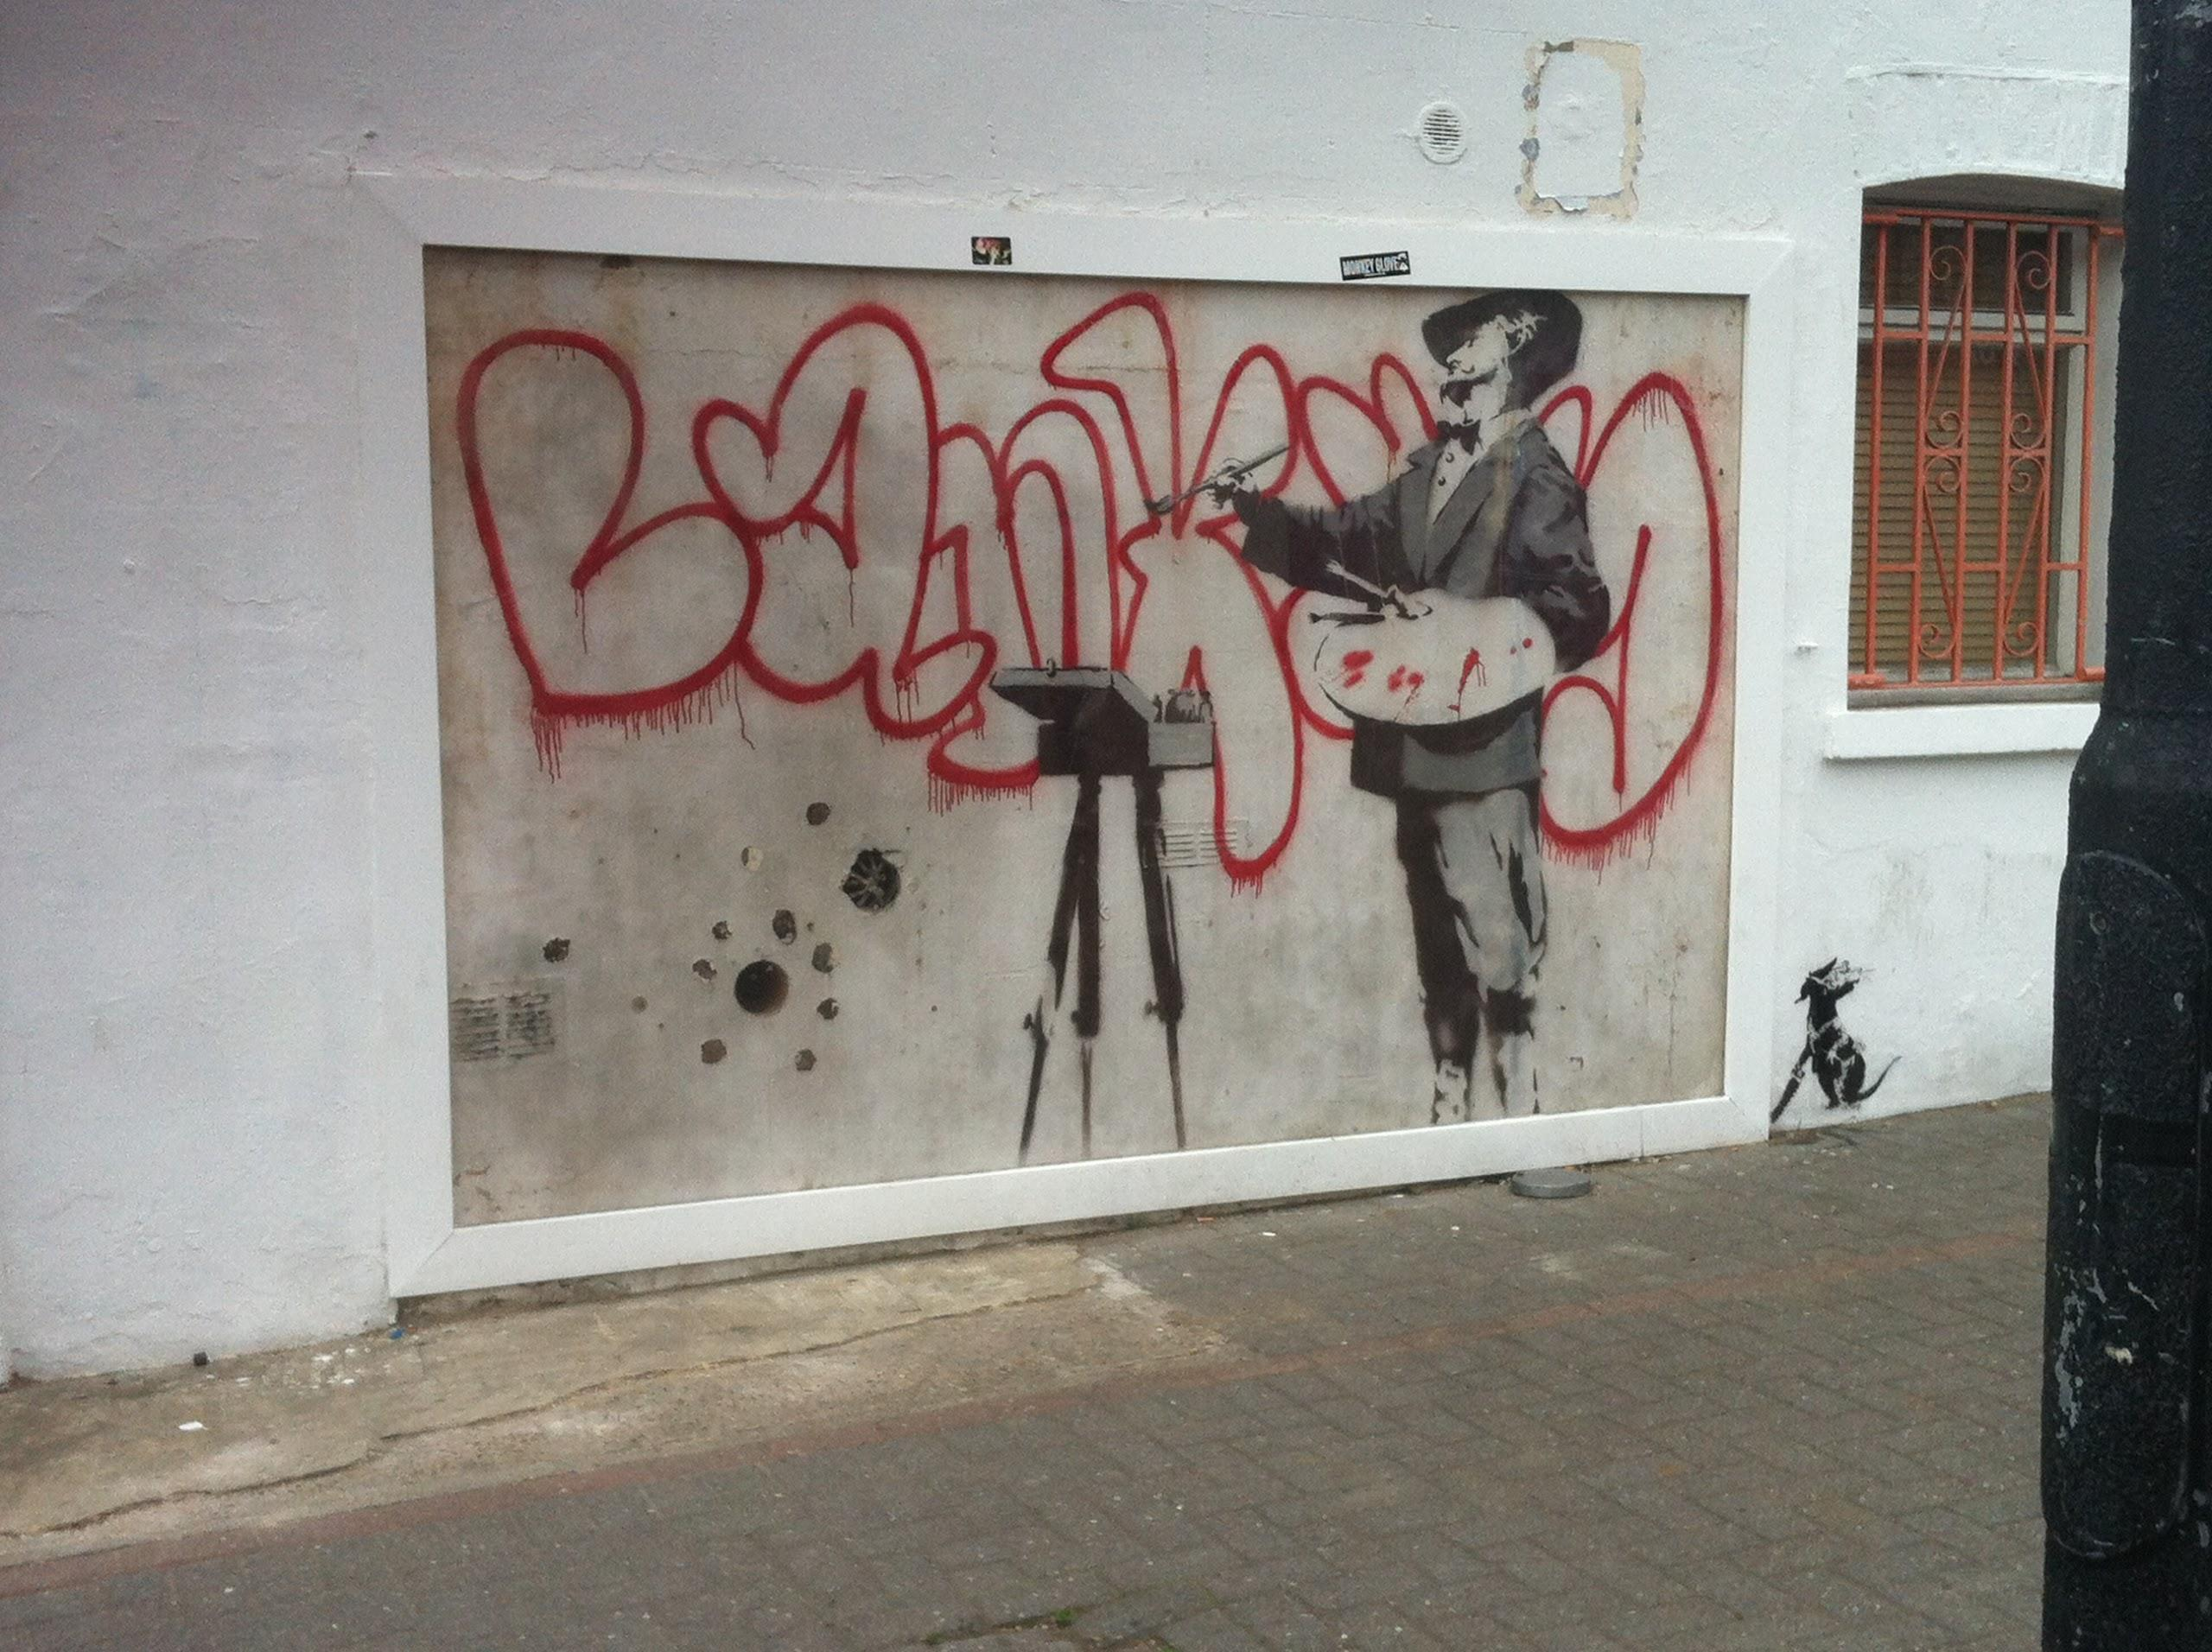
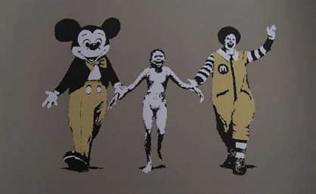

Slide 2
Banksy’s Graffiti: An in-depth Analysis of “Napalm Girl”
Katie Ward
Notes:
a. Thesis
b. Method of analysis – Perspective by incongruity
c. Why I care
d. Audience relevance

Slide 3
Preview
Background
Critical Approach
Analysis
Implications

Slide 4
Background - Banksy
Began in the early 1990s
‘Britain’s most celebrated graffiti Artist’ (Dickens, 2008)
Anonymous
Activist
Controversial & Satirical
“It is art's task to make manifest the contradictions of Being…to form
equitable views by stirring up
contradictions within the spectator's
mind, and to forge accurate
intellectual concepts from the dynamic
clash of opposing passions”

Slide 5
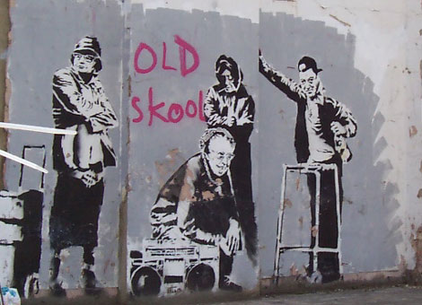
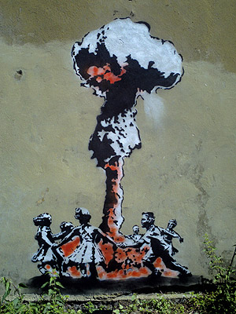
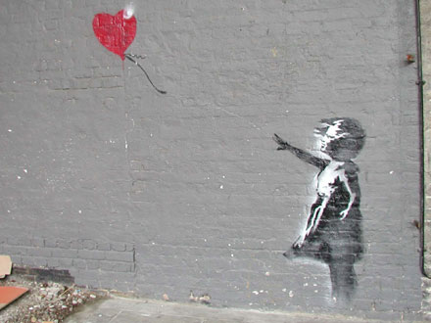
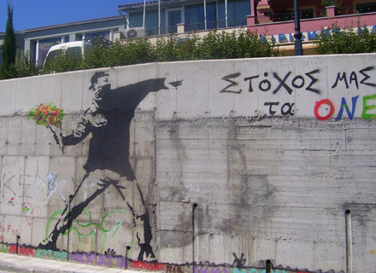
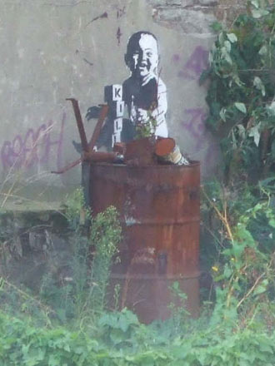
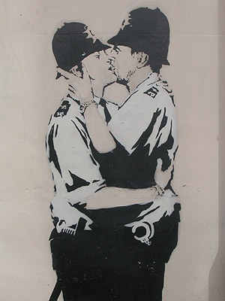
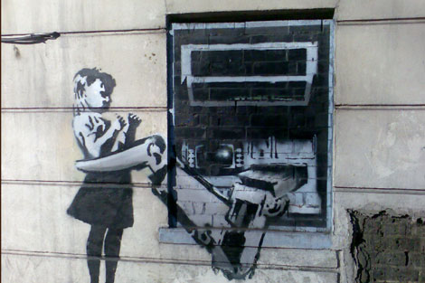
Source: bbc.co.uk/london/

Slide 6
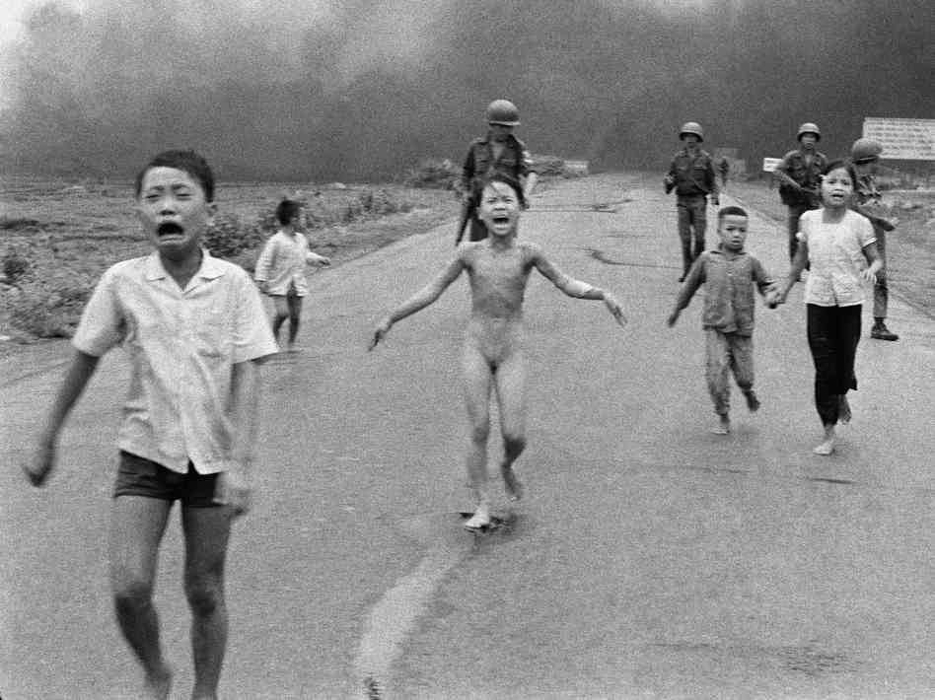
Background -
“Accidental Napalm Attack”
Phan Thi Kim Phuc
Vietnam War
Missed target
Represents futility &
damage of Vietnam war
“one of the most infamous images of conflict ever captured.”

Slide 7
Perspective by Incongruity
Critical approach
Kenneth Burke
Uses the juxtaposition of oppositional terms to create new meaning

Slide 8
Analyzing ‘Meaning’
Anti-Consumerism
Overexposed photo + Mickey and Ronald = Exploitation
Materialism through comparison
Anti-Capitalism
Combination of anti-war and anti-consumerism
“We can't do anything to change the world until capitalism crumbles. In the meantime we should all go shopping to console ourselves,” (Banksy).
Anti-War
Use of Phan Thi Kim Phuc
American Icons = America’s involvement

Slide 9
Implications
to think of other countries, societies, communities and humanities that we forget and neglect in our self-centralized worlds
Moral code
Change evoking emotion
Making people think

Slide 10
Conclusion
Speak softly, but carry a big can of paint (Banksy, 2006).

